Slide 1


Upskilling and Reskilling for the AI Era
This presentation explores the critical need for upskilling and reskilling in the face of rapid AI adoption.
by Akshay Damodar

Slide 2
The Importance of Upskilling and Reskilling in the Age of AI
Embracing Change
Increased Productivity
Competitive Advantage
AI is rapidly changing the job landscape, demanding new skills and knowledge.
Upskilling and reskilling enable employees to leverage AI for enhanced efficiency and productivity.
Organizations that invest in AI upskilling gain a competitive edge in the talent market.

Slide 3
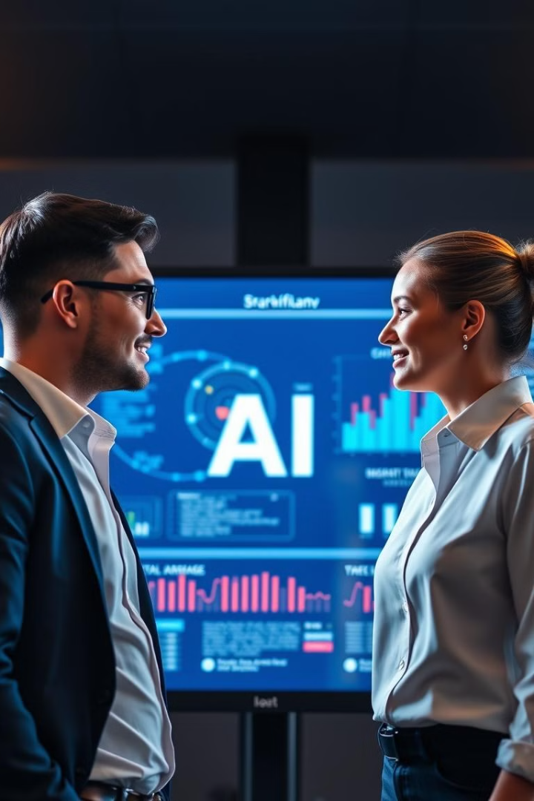
The Current Landscape: Employer and Worker Perspectives
Employer Demand
Employee Readiness
Employers are actively seeking AI-skilled talent, leading to a gap between demand and supply.
Workers are increasingly recognizing the importance of AI skills for career advancement and job security.
Skill Gaps
A significant gap exists between the skills required for AI-driven roles and the skills currently possessed by the workforce.

Slide 4




The Gender Gap in AI Skills Development
Underrepresentation
Disparity in Access
Women remain significantly underrepresented in AI fields, perpetuating a gender gap.
Women often lack access to the same opportunities and resources for AI education and training.
Addressing Bias
Addressing the gender gap is crucial to ensure inclusive and equitable AI development and deployment.

Slide 5

Risks of Uneven AI Training and Adoption
1
Skill Polarization
Uneven AI training can exacerbate skill disparities and widen the gap between those with and without AI expertise.
2
Job Displacement
Without adequate upskilling, AI adoption could lead to job displacement as automation replaces certain roles.
3
Ethical Concerns
Unethical AI training and development can perpetuate existing biases and create unintended social consequences.

Slide 6




Employer Responsibilities for AI Upskilling
Invest in Training
Create Opportunities
Promote Collaboration
Employers should prioritize investments in AI training programs to equip employees with the necessary skills.
Provide opportunities for employees to apply their new AI skills in practical projects and real-world settings.
Encourage collaboration between AI experts and employees to facilitate knowledge sharing and skill development.

Slide 7



Strategies for Effective AI Upskilling
Needs Assessment
1
Start with identifying the specific AI skills needed for current and future roles.
Personalized Learning
2
Offer tailored training programs that cater to individual learning styles and career goals.
Hands-on Experience
3
Incorporate practical projects and simulations to provide real-world application of AI concepts.

Slide 8
Leveraging Partnerships for AI Upskilling
Educational Institutions
1
Partner with universities and colleges to develop and deliver AI-focused curriculum.
Industry Associations
2
Collaborate with industry associations to access specialized AI training programs and resources.
Government Initiatives
3
Leverage government programs and funding opportunities to support AI upskilling initiatives.

Slide 9

Employee Empowerment Through Continuous Learning
1
2
Personalized Pathways
Mentorship Programs
Provide employees with customized learning paths that align with their career goals and interests.
Offer mentorship opportunities to connect employees with AI experts and experienced professionals.
3
Peer-to-peer Learning
Encourage knowledge sharing and collaboration among employees through peer-to-peer learning groups.

Slide 10


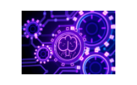
Cultivating a Culture of AI Readiness

